Slide 1

Airbnb
Asheville, NC

Slide 2
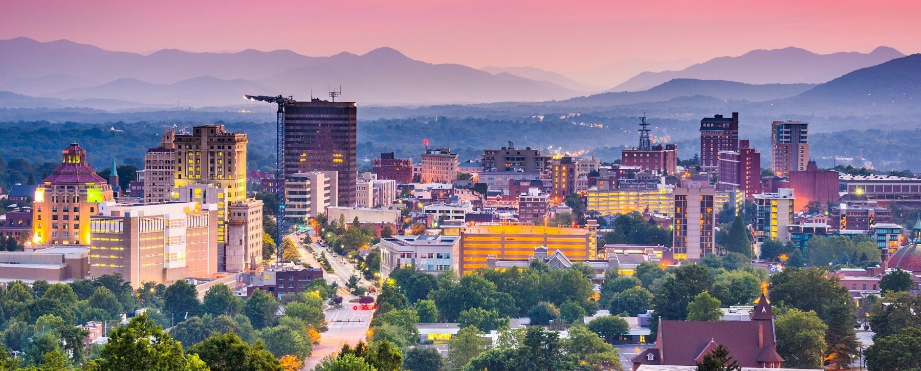

Slide 3
Audience
Airbnb Pricing Team - Marketing & Accounting
Hosts submitting NEW listings and updating existing listings

Slide 4
Goals
Suggest a basic pricing system based on data set
Earnings for hosts
Price
Price
Room type
Bedrooms
Neighborhood
Amenities
Maximize
Per night
Criteria

Slide 5
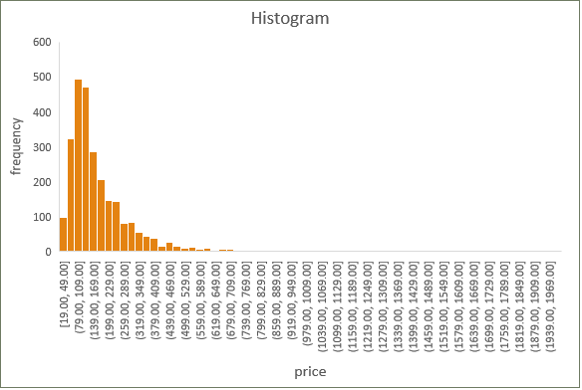
Data Summary
insideairbnb.com Asheville, NC – listings.csv.gz
Number of listings: 2,625
Average: $180.40
Median: $134.00
Maximum: $1,980.00
Minimum: $19.00
$79-$139 most frequently occurring

Slide 6
Room Type

Slide 7
Room Type
Room Type | Count of price % | Count of price | Sum of price | Average of price | Median
Entire home/apt | 84% | 2,211 | $ 426,421.00 | $ 192.86 | $ 144.00
Hotel room | 1% | 17 | $ 7,779.00 | $ 457.59 | $ 356.00
Private room | 15% | 390 | $ 44,840.00 | $ 114.97 | $ 83.00
Shared room | 0% | 8 | $ 500.00 | $ 62.50 | $ 34.00
Grand Total | 100% | 2,626 | $ 479,540.00 | $ 182.61

Slide 8
- Entire home/apt
Bedrooms
Entire home/apt | Average of price
Bedrooms | $ 192.86
1 | $ 124.54
2 | $ 183.52
3 | $ 255.75
4 | $ 361.99
5 | $ 493.38
6 | $ 620.58
7 | $ 1,021.00
8 | $ 1,824.00
9 | $ 1,318.00
Correlation coefficient: 0.904

Slide 9
Bedrooms – entire home/apt:
Average – base = surcharge
Entire home/apt | Average of price | Count of price
Bedrooms | $ 192.86 | 2211
1 | $ 124.54 | 837
2 | $ 183.52 | 636
3 | $ 255.75 | 377
4 | $ 361.99 | 142
5 | $ 493.38 | 39
6 | $ 620.58 | 19
7 | $ 1,021.00 | 7
8 | $ 1,824.00 | 1
9 | $ 1,318.00 | 2
Base: $125
Bedrooms | Surcharges (+)
1 | -
2 | $ 65.00
3 | $ 135.00
4 | $ 240.00
5 | $ 375.00
6 | $ 585.00
7 | $ 820.00
8 | $ 1,100.00
9 | $ 1,200.00

Slide 10
Pricing System
Entire home/apt
Base | $ 125.00
1 + | -
2 + | $ 65.00
3 + | $ 135.00
4 + | $ 240.00
5 + | $ 375.00
6 + | $ 585.00
7 + | $ 820.00
8 + | $ 1,100.00
9 + | $ 1,200.00
Bedrooms
Room Type | Average of price | Median
Hotel room | $ 457.59 | $ 356.00
Private room | $ 114.97 | $ 83.00
Shared room | $ 62.50 | $ 34.00
Hotel room - $355
Private room - $115
Shared room - $60
Now, we have a basic pricing system based on room type.

Slide 11
Location

Slide 12
Location - Neighborhood
Neighborhood | Average of price
28801 | $218.95
28803 | $200.32
28732 | $196.74
28804 | $193.37
28805 | $177.63
28704 | $172.02
28715 | $162.36
28806 | $144.54
Grand Total | $182.61

Slide 13
Location - Neighborhood
 | Count of price
Neighborhood | high | low | medium | Grand Total
28801 | 43% | 22% | 35% | 100%
28806 | 16% | 38% | 47% | 100%
28804 | 35% | 24% | 41% | 100%
28803 | 29% | 30% | 41% | 100%
28805 | 27% | 34% | 39% | 100%
28704 | 24% | 32% | 44% | 100%
28715 | 24% | 24% | 51% | 100%
28732 | 27% | 31% | 42% | 100%
Grand Total | 29% | 30% | 42% | 100%
$ 0-100 | low
$ 100-200 | medium
$ 200+ | high
price category

Slide 14

Location - Neighborhood
Neighborhood | Average of price
28801 | $ 218.95
28803 | $ 200.32
28732 | $ 196.74
28804 | $ 193.37
28805 | $ 177.63
28704 | $ 172.02
28715 | $ 162.36
28806 | $ 144.54
Grand Total | $ 182.61
28801 | Count of price
Bedrooms | 619
1 | 347
2 | 191
3 | 38
4 | 7
5 | 3
6 | 3
7 | 1
Most listings are 1 bedroom, therefore imply that location, not size contributes to high average price of $218.95, $36.00 above average.
$36.00
Downtown

Slide 15
Neighborhood premiums
Neighborhood average – overall average = surcharge
Neighborhood | Average of price | (+/-)avg
Grand Total | $182.61
28801 | $218.95 | +$36.00
28803 | $200.32 | +$18.00
28732 | $196.74 | +$14.00
28804 | $193.37 | +$11.00
28805 | $177.63 | ($5.00)
28704 | $172.02 | ($11.00)
28715 | $162.36 | ($20.00)
28806 | $144.54 | ($38.00)
0
0
0
0

Slide 16
Pricing System
Entire house/apt
Base | $ 125.00
1 + | -
2 + | $ 65.00
3 + | $ 135.00
4 + | $ 240.00
5 + | $ 375.00
6 + | $ 585.00
7 + | $ 820.00
8 + | $ 1,100.00
9 + | $ 1,200.00
Bedrooms
Hotel room - $355
Private room - $115
Shared room - $60
Neighborhood Premium
28801 | $36.00
28803 | $18.00
28732 | $14.00
28804 | $11.00
28805 | -
28704 | -
28715 | -
28806 | -

Slide 17
Amenities

Slide 18

WiFi
WiFi | Average of price
yes | $ 183.03
no | $ 137.25
Grand Total | $ 182.61
$45.78
How?
=If(search())

Slide 19

Kitchen
Kitchen | Average of price
yes | $ 195.14
no | $ 129.76
Grand Total | $ 180.40
$65.38

Slide 20

Breakfast
Breakfast | Average of price
yes | $ 192.42
no | $ 179.21
Grand Total | $ 180.40
$13.21

Slide 21

Pool
Pool | Average of price
yes | $ 254.85
no | $ 177.42
Grand Total | $ 180.40
$77.43
Divide by 2 because they’re already factored into the overall average pricing a little.

Slide 22
Pricing System
Entire house/apt
Base | $ 125.00
1 + | -
2 + | $ 65.00
3 + | $ 135.00
4 + | $ 240.00
5 + | $ 375.00
6 + | $ 585.00
7 + | $ 820.00
8 + | $ 1,100.00
9 + | $ 1,200.00
Bedrooms
Hotel room - $355
Private room - $115
Shared room - $60
Neighborhood Premium
28801 | $36.00
28803 | $18.00
28732 | $14.00
28804 | $11.00
28805 | -
28704 | -
28715 | -
28806 | -
WiFi $22.00
Kitchen $33.00
Breakfast $7.00
Swimming Pool $39.00

Slide 23
What are we missing? Next steps…
More Data
Cleaning fees – cleaning/pay rate, average cleaning times
Cost – repairs and maintenance, supplies, heating/cooling, landscaping, etc.
Sales – how much are these prices selling? What exactly sells people on listings?
Design/Aesthetics
Energy types
Mortgage/depreciation
Property Tax
HOA
Events nearby, sports, music, proximity to sports, nature, location, activities, etc.

Slide 24
Thank you

